Slide 1

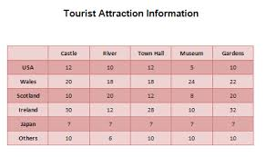
Tables in Word

Slide 2
Purpose of Tables
Tables give you a way to arrange content in rows and columns. This is a handy way to present information that is categorized or grouped e.g criteria for items on a shopping list, or phone numbers and e-mail addresses for a list of contacts.

Slide 3
Insert a Table
Insert tab
In the Tables group, click Table
Drag to select the number of rows and columns that you want.
Insert Table

Slide 4
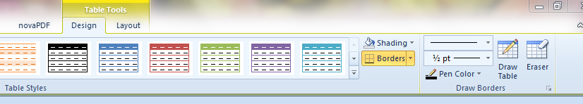
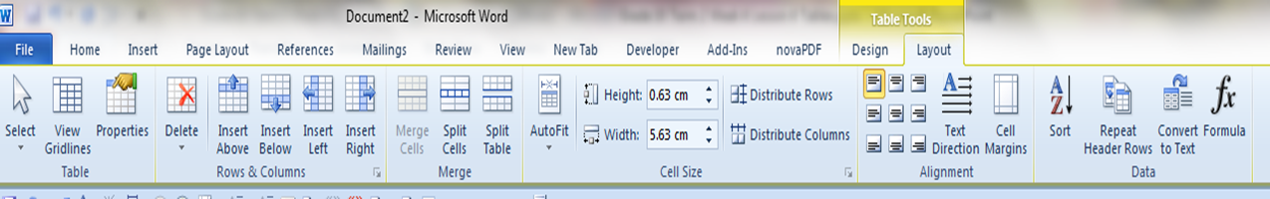
After inserting a Table the following should appear:
Table tools
Layout
Design

Slide 5
Table Properties
Size – Specifies the preferred width of the entire table. By default new tables fill up the
page from the left to the right margin. (This setting may be overridden by content and other property settings.)
 Alignment – Positions the table relative to the margins of the page. This does NOT affect
alignment of text within cells.
Text Wrapping – Can allow surrounding text to wrap around the table. (The Positioning button will control position of the table relative to the text.)
Borders and Shading – Performs the same function as the Borders and Shading command
in the Format menu.


Slide 6
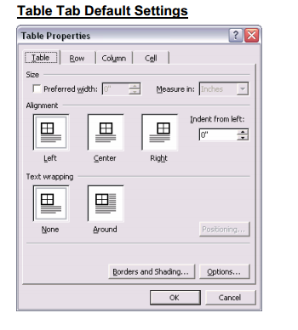
Table Properties allow to change various settings

Slide 7
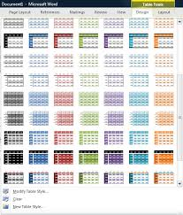
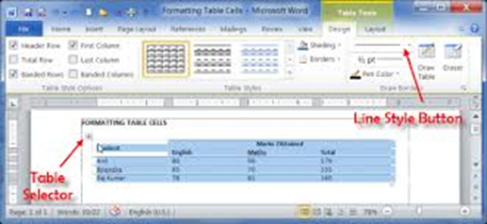

Activity
Learner’s worksheet in DataFiles_Solutions Folder

